Slide 1
Children cost to parents, the elderly cost to taxpayers: An application of NTA and NTTA Gal, RI, Szabo, E and Vargha, L
European Time Use and NTA Workshop
Stockholm, November 8-9, 2012

Slide 2
Two asymmetries motivate the creation of NTTAs
- Gender asymmetry in division of labor: an NTA exercise by gender limited to the national accounts would give a distorted picture of gender participation in interage resource reallocations.
- Asymmetric socialization: upward flowing reallocations are exported to a larger extent from households to non-household institutions than downward flowing reallocations are. This results in a different institutional composition of funding the two dependent sections of the life-cycle.

Slide 3
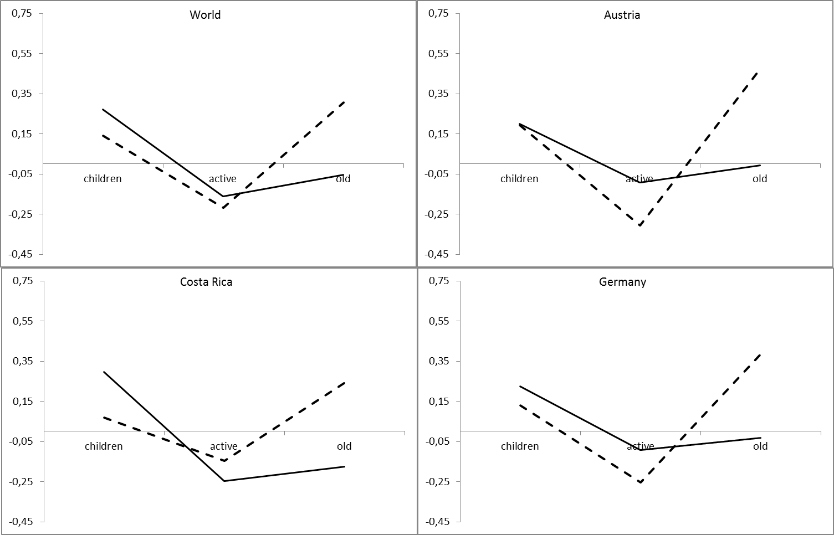
Asymmetric socialization in NTA Age-distribution of net intra-household transfers (solid line) and net public transfers (dashed line) in 13 countries

Slide 4
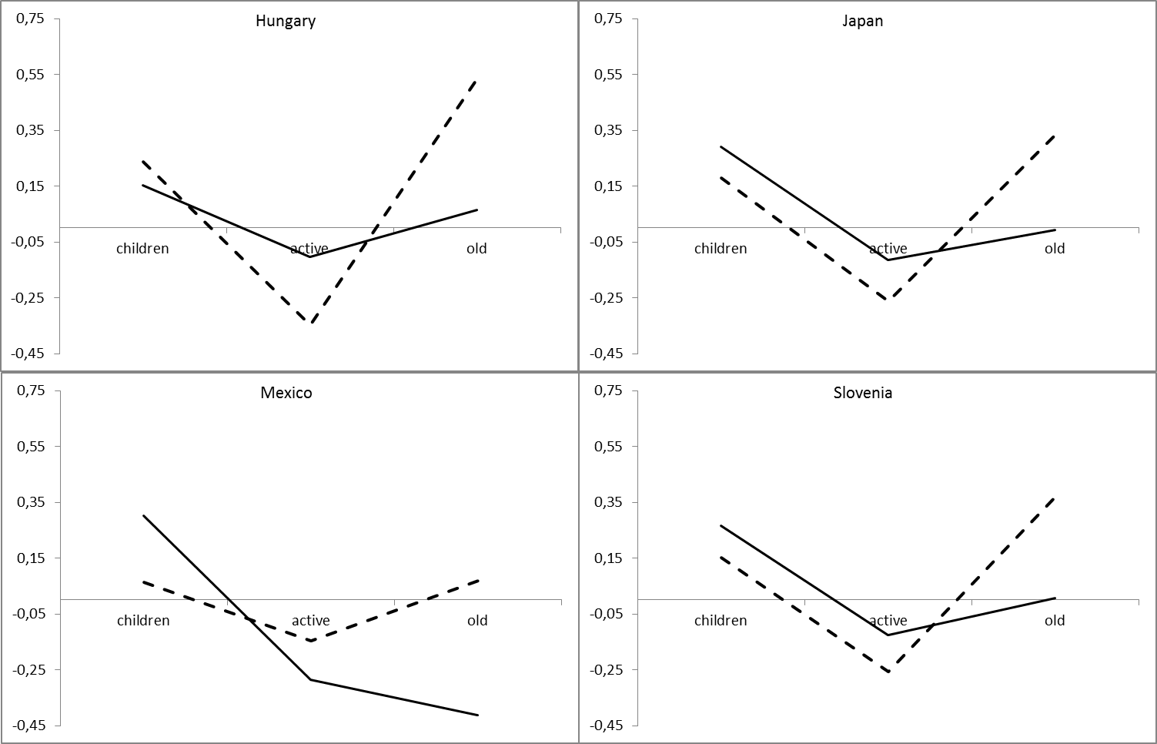
Contd.

Slide 5
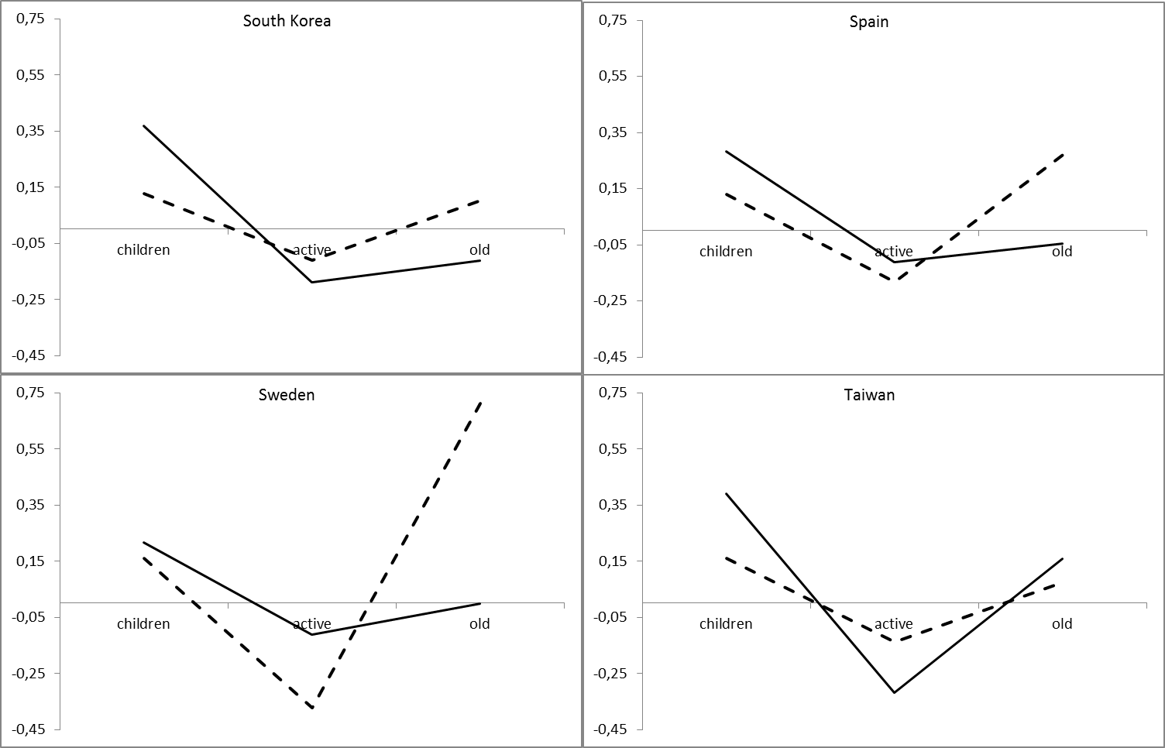
Contd.

Slide 6
Contd.
Calculation based on NTA data (www.ntaccounts.org).
Values are normalized on per capita labor income of the 30-49 age bracket of the respective country. “World” is unweighted average of country values.
Intra-household transfers are higher than public transfers in childhood (exception: HU) and lower in old age (exception: TW).

Slide 7
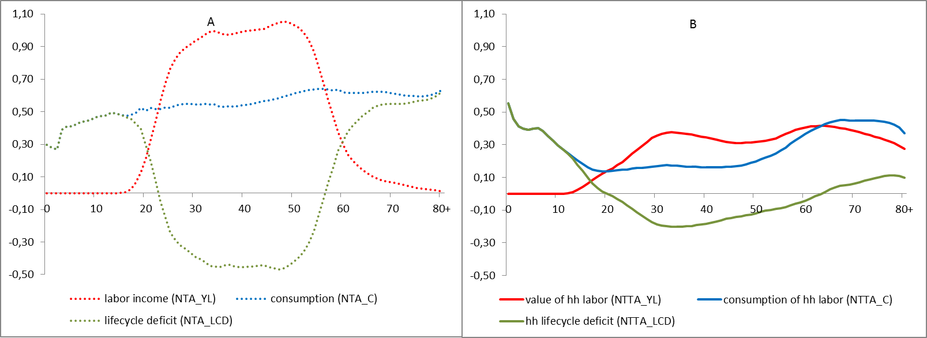
Asymmetric socialization appears to be even more explicit if time transfers are also taken into consideration. The age-profile of the NTTA_LCD, a time-transfer equivalent of intrahousehold transfers, is rather different than that of the NTA_LCD.
YL, C and LCD in NTA and NTTA, Hungary, 2000
Values are normalized on per capita labor income (NTA) of the 30-49 age bracket.

Slide 8
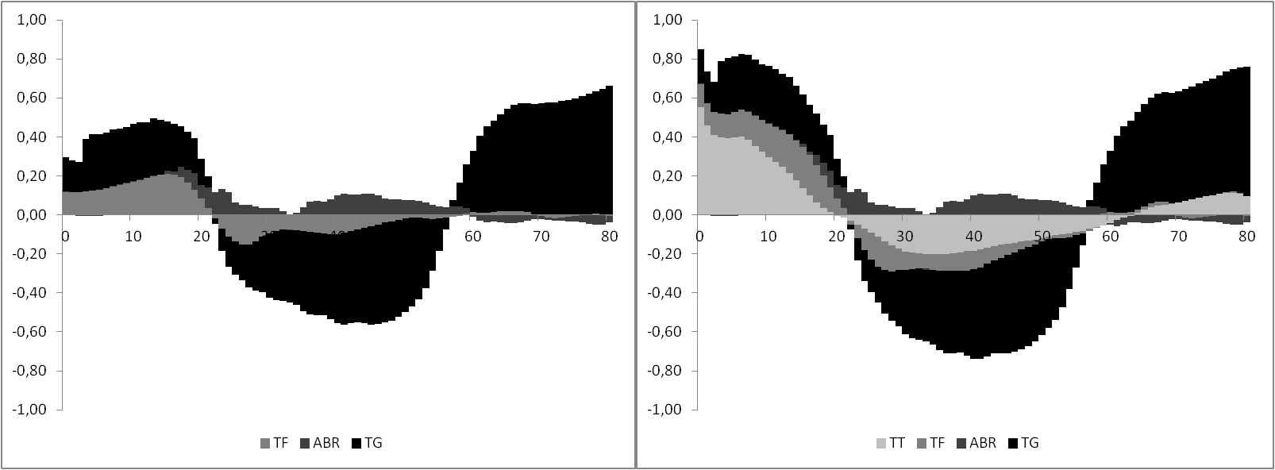
Financing the life-cycle deficit in NTA and in NTA+NTTA
Taking time transfers into account changes the private/public ratio in childhood significantly but has little effect in old age: children do cost to parents whereas the elderly cost to the taxpayer.
Time transfers (TT), private transfers (TF), asset-based reallocations (ABR) and public transfers (TG) in NTA and NTTA, Hungary, 2000
Values are normalized on per capita labor income (NTA) of the 30-49 age bracket.

Slide 9
Policy relevance
The welfare state breaks or at least weakens the institutional link between opposite flows anyway.
This effect is amplified if the welfare state does not take into account interage reallocations other than public transfers.
In particular, externalities are created on efforts of raising children, which results in the usual consequence of suboptimal supply.

Slide 10
Another asymmetry: gender differential in unpaid household labor
YL, C and LCD in NTTA by gender, Hungary, 2000
Values in local currency.

Slide 11
Policy relevance
The welfare state ignores alternative providers of interage reallocations.
In order to overcome some of the negative consequences leeways are invented such as the mandatory application of unisex life tables by public pension schemes or survivors’ pension.
Taking into account alternative providers such as the household would make most of these compensatory efforts redundant.

